Slide 1
Active Electronic Components
An active electronic component either amplifies or switches.
  The most common active components are diodes and transistors.
  Both diodes and transistors are easy to make with semiconductors
With semiconductor materials it is possible to create complete circuits of active and/or passive components wired together.
  These circuits are formed on a single chip of silicon and are called integrated circuits (ICs).
A presentation of eSyst.org

Slide 2
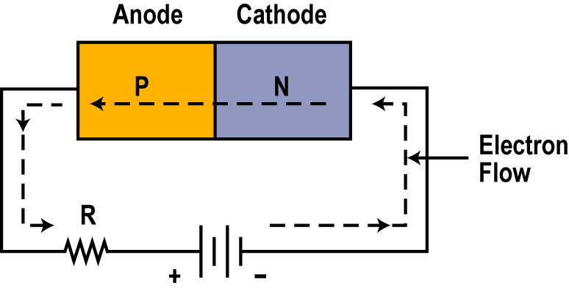
Diodes
A semiconductor diode is formed with pieces of N and P-type material are joined.
  The P material is called the anode.
  The N material is called the cathode.
  The resulting structure is called a PN junction.
A PN junction (or diode) is a switch or component through which electrons will flow easily in one direction but not in the opposite direction.
A presentation of eSyst.org

Slide 3
Biasing a PN Junction
To get current to flow in PN junction or diode, you have to apply an external voltage called bias.
With this connection, current only flows freely from cathode across the junction to the anode.
You’d say the switch is closed when electrons can flow through the diode.
Note: The current flow may be so high that an external resistance R is usually needed to minimize the current flow to a level a diode can withstand.
This arrangement is called forward bias.
A presentation of eSyst.org

Slide 4
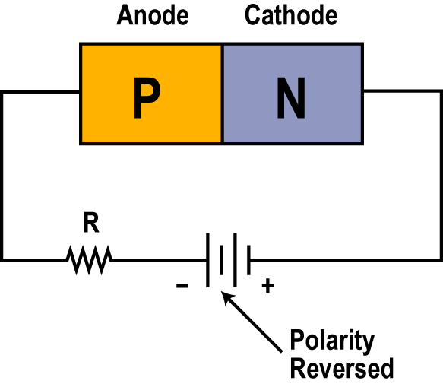
Reverse Bias
A diode with the external voltage polarity reversed is called reverse bias.
  With this connection no current will flow.
  You’d say the switch is open when electrons can’t flow through the diode.
A presentation of eSyst.org

Slide 5
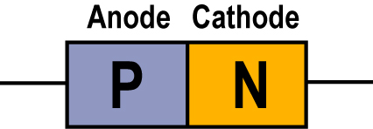
Diode Symbol
The PN junction forms a diode.
To represent the diode in schematic diagrams, we use the symbol shown on the right.
Note the designations for the anode and cathode.
A presentation of eSyst.org

Slide 6
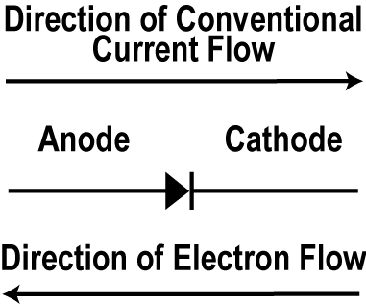
Diode Current Flow
The direction of current flow (electrons) is shown by the arrow.
A presentation of eSyst.org

Slide 7
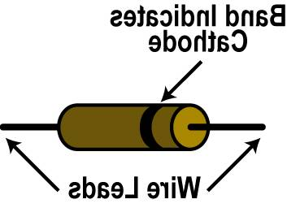
A Practical Diode
A practical diode has two wire leads.
Note the end with the band circling the body is the cathode end.
Wire Leads
A presentation of eSyst.org

Slide 8
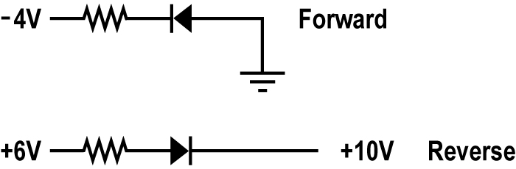
Forward and Reverse Bias
Examples of both forward and reverse biased diodes:
A presentation of eSyst.org

Slide 9
Practical Diodes
Diodes, like other electronic components, are not perfect.
Diodes have an upper current limit that if exceeded will destroy the diode.
You can get diodes with current limits of a few milliamperes up to hundreds or thousands of amperes.
Diodes also have an upper voltage limit when reverse biased.
This is the reverse break down voltage which may be only a few volts or hundreds or thousands of volts.
A presentation of eSyst.org

Slide 10
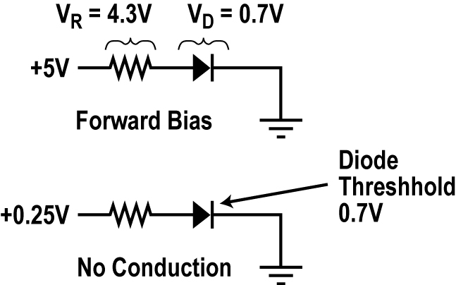
Diode Voltage Drop
Diodes also have a voltage drop while they are conducting. This is called forward voltage drop. It is in the 0.5 to 0.9 volt range for silicon diodes. A typical value is 0.7 volts.
The forward drop in a germanium diode is in the 0.2 to 0.4 volt range.
Diodes also have a threshold voltage approximately equal to the forward voltage drop. This is the minimum amount of forward voltage that must be applied to get the diode to conduct.
For example if you apply a forward bias of less than abut 0.7 volts to a silicon diode, it will not conduct. As soon as the bias voltage rises about 0.7 volts the diode will conduct.
A presentation of eSyst.org

